Slide 1
Decision Tree Primer
Ravi Starzl, PhD
Fall 2023

Slide 2

Entropy
For a binary classification, the entropy H(D) of a dataset D is calculated as:
Where:
p+​ is the proportion of positive samples in D
p−​ is the proportion of negative samples in D
Notes:
To understand information gain, we first need to understand entropy. Entropy measures the impurity or disorder in a set.

Slide 3
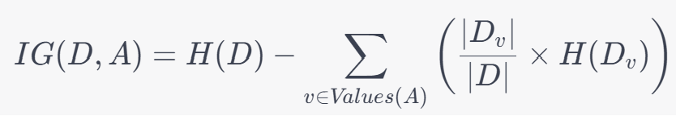
Information Gain
The information gain IG(D,A) for a dataset D and attribute A is:
Where:
Values(A) are the different values that attribute A can take.
Dv​ is the subset of D for which attribute A has value v.
Notes:
Information gain is the reduction in entropy achieved by partitioning a dataset based on an attribute.

Slide 4
Steps to Grow a Tree
Initialization: Start with the entire dataset.
Termination: If all instances in the dataset have the same class, or other stopping criteria are met (like a maximum depth), create a leaf node with the majority class.
Attribute Selection: For each attribute, calculate the information gain. Choose the attribute with the highest information gain.
Partitioning: Split the dataset into subsets based on the chosen attribute.
Recursion: For each subset, repeat the process from step 2.

Slide 5
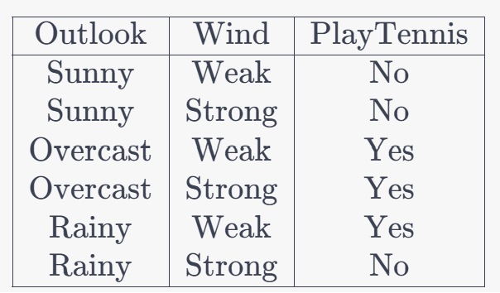
Example
We want to predict the "PlayTennis" attribute using the "Outlook" and "Wind" attributes.
Step 1: Calculate the entropy of the entire dataset.
Step 2: For each attribute ("Outlook" and "Wind"), calculate the information gain.
Step 3: Choose the attribute with the highest information gain to split the data.
Step 4: Continue this process recursively for each subset until a leaf node is reached.

Slide 6
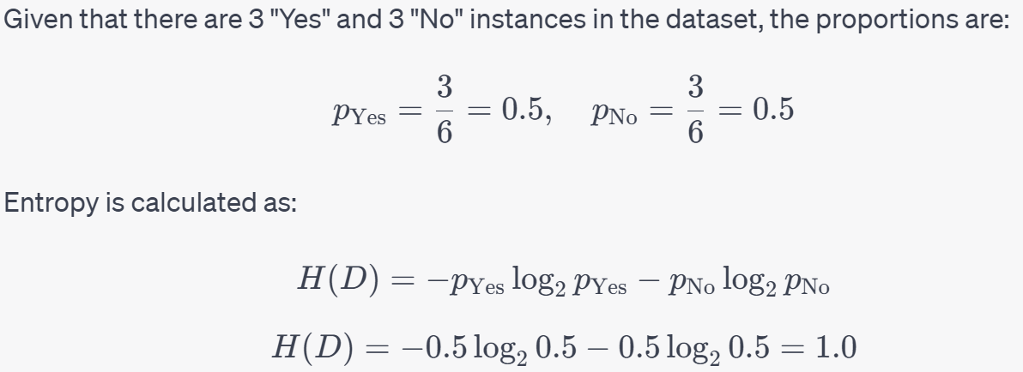
Example

Slide 7
Example
The entropy of the entire dataset is calculated to be 1.0.
Next, we calculate the information gain for each attribute.
Step 2: For the "Outlook" attribute, we:
Partition the data based on each possible value of "Outlook" (Sunny, Overcast, Rainy).
Calculate the entropy for each subset.
Calculate the weighted average of these entropies based on the size of each subset.
Subtract this weighted average from the entropy of the entire dataset to get the information gain for the "Outlook" attribute.

Slide 8
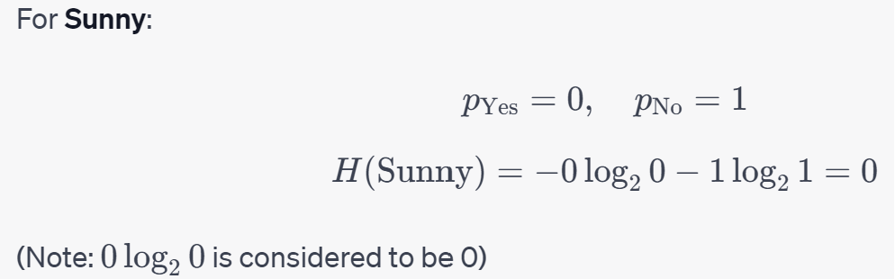
Example

Slide 9
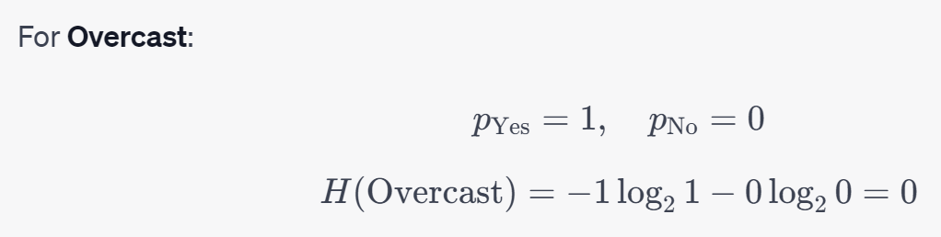
Example

Slide 10
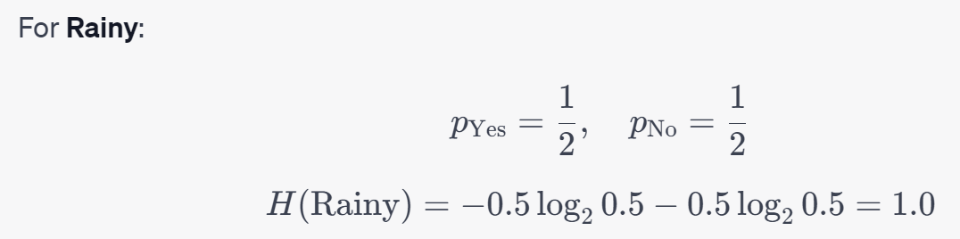
Example

Slide 11
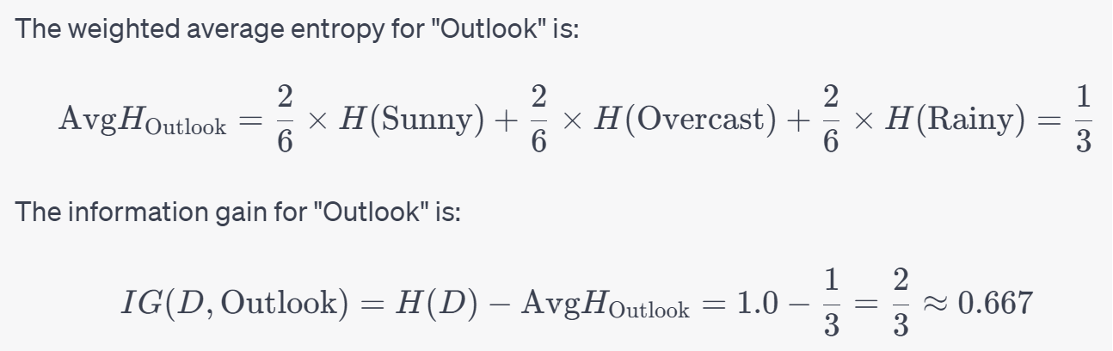
Example

Slide 12
Example
The information gain for the "Outlook" attribute is approximately 0.667.
Now, we'll repeat the process for the "Wind" attribute:
Partition the data based on each possible value of "Wind" (Weak, Strong).
Calculate the entropy for each subset.
Calculate the weighted average of these entropies based on the size of each subset.
Subtract this weighted average from the entropy of the entire dataset to get the information gain for the "Wind" attribute.

Slide 13
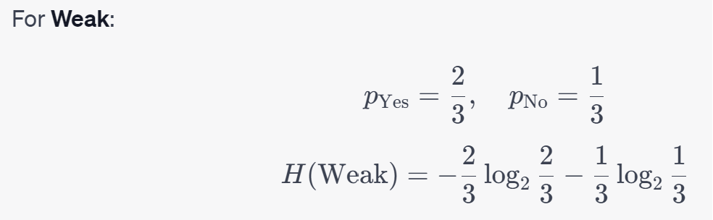
Example

Slide 14
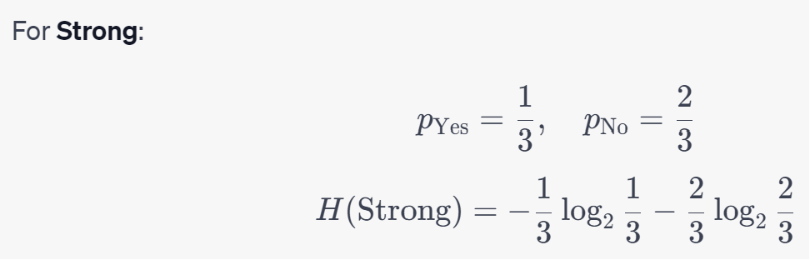
Example

Slide 15
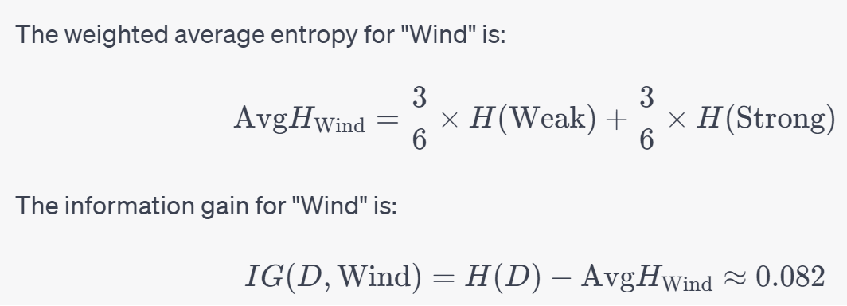
Example

Slide 16
Example
The information gain for the "Wind" attribute is approximately 0.082.
Step 3: Choose the attribute with the highest information gain to split the data:
Information Gain for "Outlook": 0.667
Information Gain for "Wind": 0.082
Clearly, the "Outlook" attribute has the highest information gain. Therefore, the best attribute to split the data on, in this case, is "Outlook".

Slide 17
Example
Step 4: Now, we would continue this process recursively for each subset created by splitting on the "Outlook" attribute. For each subset, we would determine if further splitting is required (e.g., if there are both "Yes" and "No" instances in a subset). If further splitting is required, we'd repeat the process of computing information gain for the remaining attributes and choosing the best attribute to split on.

Slide 18
So How To “Split”?
E.g. if Sunny = yes is the splitting criterion selected, move all the Sunny=yes instances into the left node, and all the Sunny=no instances into the right node.
Recursively repeat the process until maximum purity is achieved
Because we are splitting on feature values, response variable labels may be mixed during the process. That’s not really under your control – it’s a by-product of the information gain process.

Slide 19
So How To “Split”?
1. Determine the Splitting Attribute:
From our calculations or any other metric (e.g., information gain, Gini impurity), we determine which attribute to split on.
2. Segregate the Data Based on the Splitting Attribute:
Once the attribute is chosen, for each possible value of this attribute, we filter the dataset and create subsets. Each subset corresponds to one possible value of the attribute.
For a binary tree:
In the case of categorical attributes: One branch corresponds to a particular category, and the other branch corresponds to all other categories.
For numerical attributes: A threshold is chosen (e.g., "Temperature <= 75"). One branch corresponds to instances where the condition is true, and the other branch is for instances where the condition is false.

Slide 20
So How To “Split”?
3. Recursion:
Each of the subsets created becomes the new dataset for the next level of the tree. We then recursively apply steps 1 and 2 on each of these subsets until we meet a stopping criterion (e.g., all instances in the subset belong to the same class, the depth of the tree reaches a predetermined value, etc.).

Slide 21
Example
Step 1: Choose "Outlook" as the splitting attribute (based on our previous calculations).
Step 2: For a binary split, let's choose "Sunny" vs. "Not Sunny".
"Sunny" Branch:
Outlook | Wind | PlayTennis
---------------------------------
Sunny | Weak | No
Sunny | Strong | No

Slide 22
Example
"Not Sunny" Branch (comprising "Overcast" and "Rainy" instances):
Outlook | Wind | PlayTennis
---------------------------------
Overcast | Weak | Yes
Overcast | Strong | Yes
Rainy | Weak | Yes
Rainy | Strong | No
Step 3: For the "Not Sunny" branch, we would further split based on the "Wind" attribute, creating subsets for "Weak" and "Strong".

Slide 23
Conclusion
In our example, the next steps would involve checking the subsets for each value of the "Outlook" attribute and deciding on further splits based on the "Wind" attribute or directly assigning a class label if no further splits are required.
This process continues until all instances in a subset belong to a single class or other stopping criteria are met, such as reaching a maximum depth for the tree.

